Slide 1
DCAF Under the Hood
Benjamin Celis, Matthew Pollock

Slide 2
Abstract
The Distributed Control and Automation Framework (DCAF) is an open-source LabVIEW framework designed to create control systems that are reliable, modular, and configurable. In this presentation we will explore the decisions behind the design as well as their implementation. We will cover in detail the data transfer mechanism, execution paradigms, and module reuse.

Slide 3
Agenda
Introduction
The Tag Bus
DCAF Modules
DCAF Engine
Additional tricks:
VI Templates
Syslog
Text to object DVR
GraphViz

Slide 4
Why We Created DCAF
Most Real Time control systems have major similarities
Including similar bugs/deficiencies
Customers expending significant effort “reinventing the wheel”
Lack of quality high-level framework for deterministic systems from NI

Slide 5
Distributed Control and Automation Framework (DCAF) Overview
An open-source LabVIEW framework for creating configurable, latest value, data engines that can acquire data from multiple input sources, process that data, and then route it back to outputs or to data services.
Engine
Input
Process
Output
Outside
Outside
Outside
Notes:
The Tag Bus Data Framework or TBDF is an open-source LabVIEW framework for creating configurable, latest value, data engines that can acquire data from multiple input sources, process that data, and then route it back to outputs or to data services. It provides a scalable and extensible plugin architecture. It supports users in the development of new plugins with a variety of templates… …and the framework was designed to allow plugins to be reused easily across projects. Reuse is easy because each plugin can define configuration parameters which can be specified using a configuration editor. This also allows plugin behavior to change across multiple deployments of the same application. While applicable to a wide variety of use-cases, the framework was primarily built for applications using a lot of single point I/O: things like control data or industrial communication protocols. The plugin architecture helps facilitate multi developer teams, and the framework handles the intricacies of execution timing and error handling for its users. Finally, while the framework can run on RT, Windows, and Interact with FPGAs, it was built primarily for applications executing on a real-time OS.

Slide 6
Who should be using DCAF
Ideal for Tag systems
Rates under 1kS/s
Dynamic systems
Allows code reuse
It is not an NI Product but has official R&D support
Not a turnkey solution
You don’t need to use DCAF but you can use what we learned creating it
Notes:
Add Link for support

Slide 7
DCAF Components
Project Templates
Configuration
Runtime
Templates
Configuration Editor
Engine
Examples
Modules
Notes:
From DevGuide
**Engine**: State machine that executes *Modules* as defined in the *Configuration Editor* and provides a namespace for *Tags*. The Engine also passes data between its *Modules* according to its *Mappings*.
**Module**: A collection of code of varying functionality that executes within an *Engine* and that can interact with the *Tags* of that *Engine*. Some standard *Modules* are installed with DCAF, but users can also create their own.
**Configuration Editor**: A LabVIEW program used to visually define the functionality of each *Engine* and *Module* in DCAF.

Slide 8
Demo

Slide 9
The Tag Bus
Current Options
Local Variable
Global Variable
Single
Functional Global Variable
Current Value Table (CVT)
Requirements
Flexibility
Scope
Performance
Notes:
DCAF was designed for systems in which the main data transfer is tags.
LabVIEW offers many options to manage tags.
But for design we had 3 main guidelines and they could not be achieved with the current options.
What's the need?
Limited Solutions:
Variables
CVT
Scope
Data Types

Slide 10

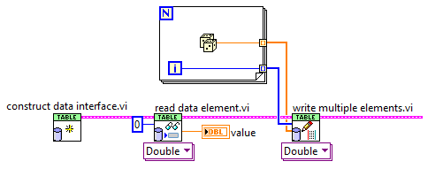
Tag Bus
CVT on the wire
Controlled Scope
Data Protection
Fast
Reduced memory copies
Filtering

Slide 11
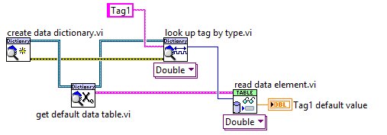
Data Dictionary

Slide 12
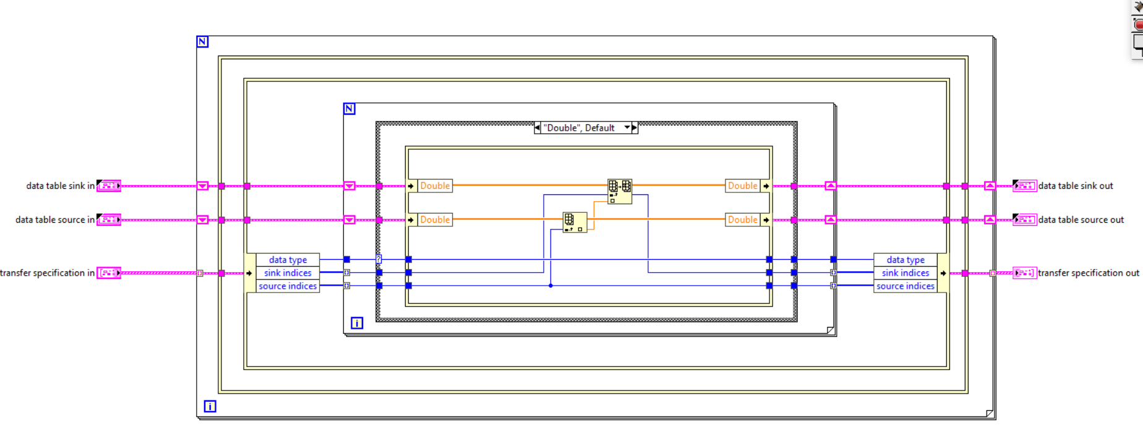
Tag Bus Duplication
Notes:
Major issue with clustersauruses: data copies of the cluster and accidentally stomping on data, especially if sending the whole cluster into every user of the cluster
Solution: break up the cluster such that each user of the cluster gets the minimum data set it needs and prevent useless data copies when getting/setting the values from the main cluster
Each DCAF module gets a “mini” tag bus containing only the data used by that module. Scripting templates take care of all data access operations on the mini-tag bus in the module for most common use cases.
Use of in-place operations, plus never branching the main tag bus wire, prevent copies of the main cluster

Slide 13
DCAF Module
Configuration
Created on PC, passed to runtime system
Provides data access and serialization/deserialization methods
Data storage only, no editor or runtime logic
Runtime Node
Initializes runtime based on configuration
Provides execution logic
Configuration
Editor node
Runtime

Slide 14
DCAF Module
Editor Node
User interface
Runs on PC
Creates or modifies the configuration
Contains the configuration class
Configuration
Editor node
Runtime

Slide 15
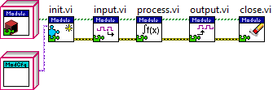
Module Runtime

Slide 16
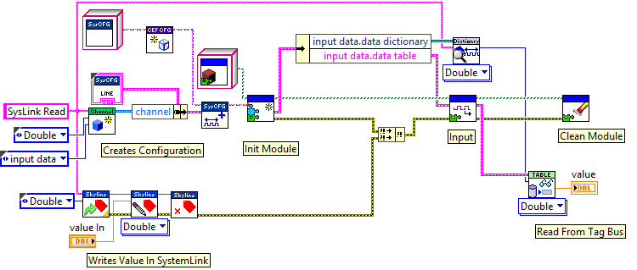
Module Runtime Test Harness Example
Notes:
Add compare between expected and read values to demo test

Slide 17
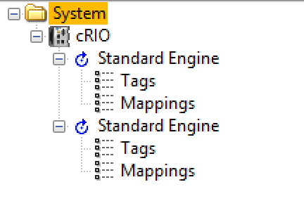
DCAF Execution Engine Interface
Can execute have multiple engines at the same time
Each Engine is a different thread
Engine controls modules execution and data transfer
Provides API to control and get access to the engines

Slide 18
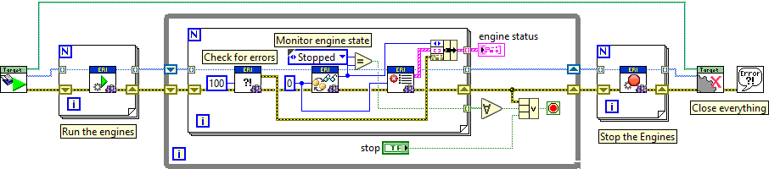
DCAF Execution Engine Interface
Can execute multiple engines at the same time
Each Engine is a different thread
Engine controls modules execution and data transfer
Provides API to control and get access to the engines

Slide 19
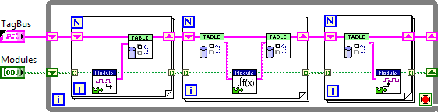
Simplified Engine

Slide 20
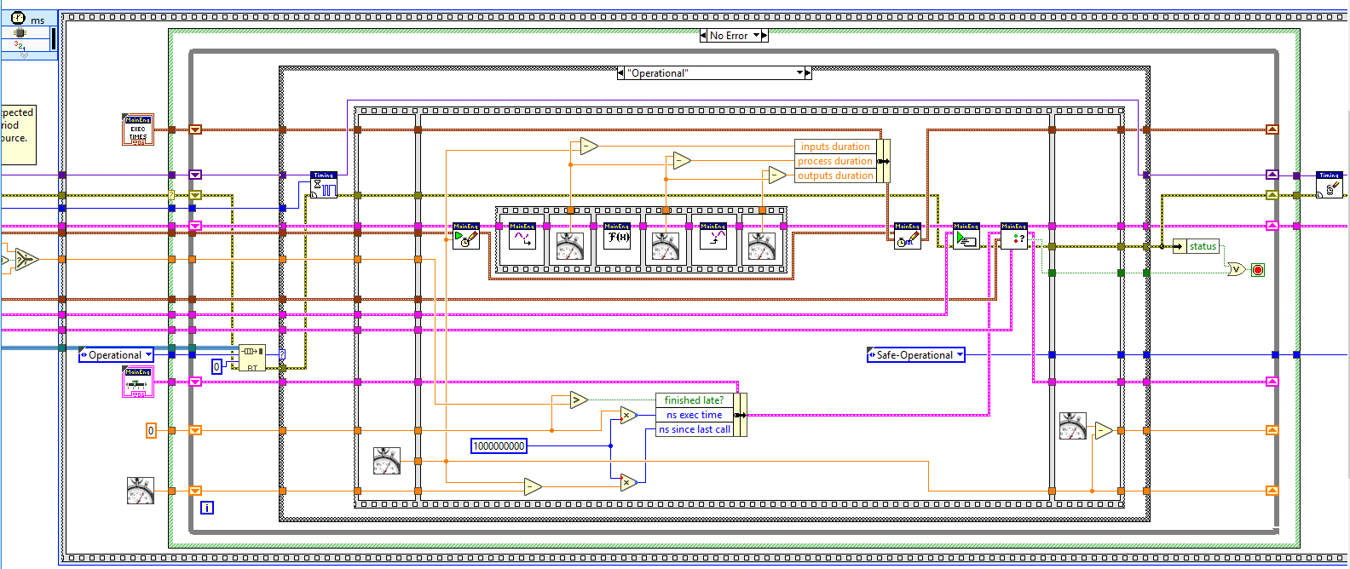
DCAF Execution Engine
Notes:
The source code for the engine isn’t as scary as you might think. It follows a pretty straightforward sequence of steps:
Check for a message to stop.
Wait for next clock source to fire.
Sequentially read all inputs and store data on the bus.
Process data and store on bus, then process again and store on the bus, then process again. Etc.
Send data to all output locations sequentially.
Choose which plugins execute on the next iteration.
Check for errors and handle them.
Sequential execution provides predictable behavior.
C:\Program Files (x86)\National Instruments\LabVIEW 2017\vi.lib\NI\DCAF\Engines\Standard Engine\Execution Engine\main engine\primary control loop.vi

Slide 21

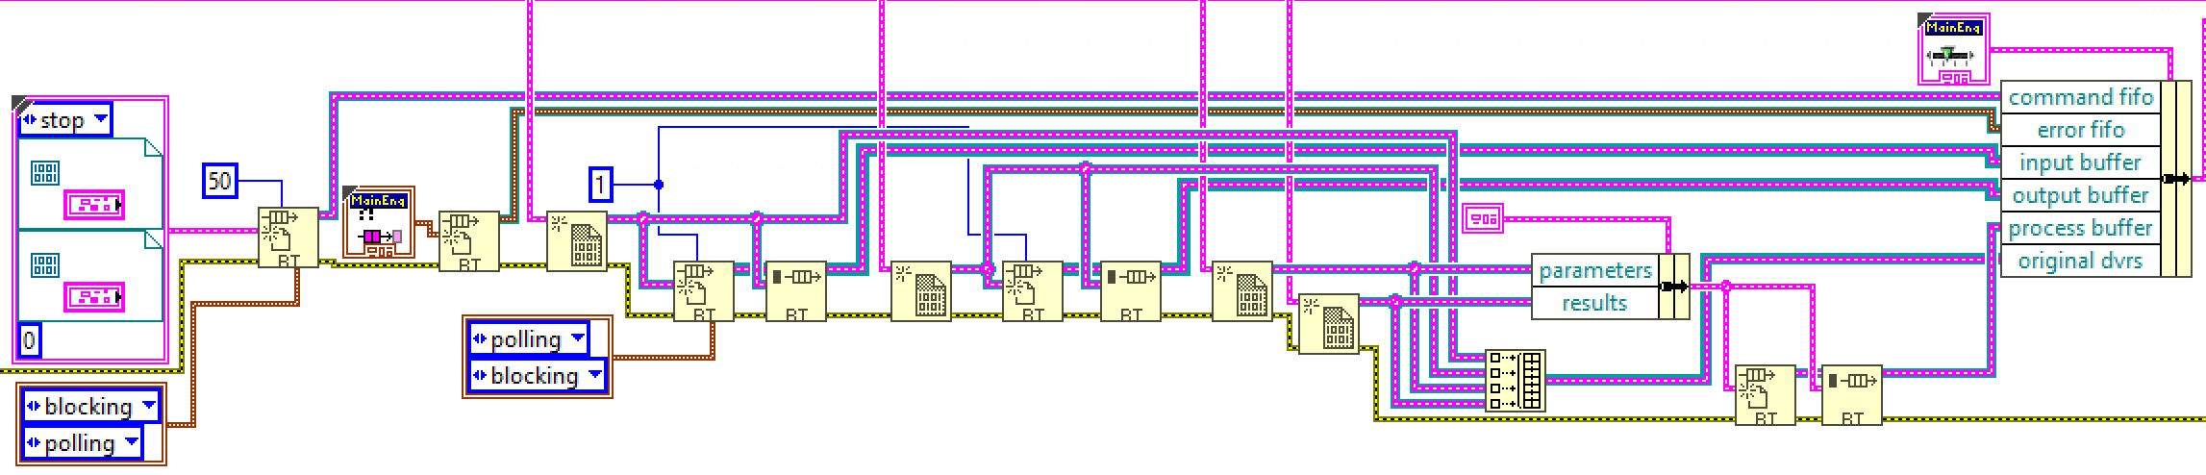
Asynchronous Modules
Creates DVRs
Creates RT FIFOs
Command FIFO
Input, Output and Process Buffer
Launches Asynchronous Worker
Notes:
C:\Program Files (x86)\National Instruments\LabVIEW 2018\vi.lib\NI\DCAF\Engines\Standard Engine\Execution Engine\async executor\start async worker.vi

Slide 22
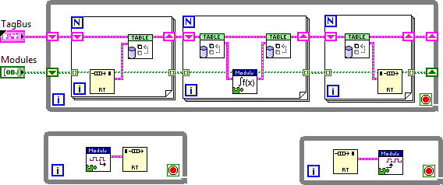
Asynchronous Module

Slide 23
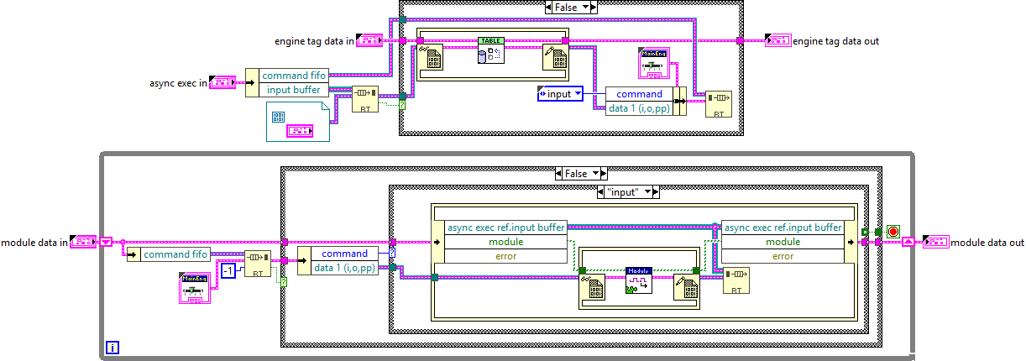
Asynchronous Module
Notes:
C:\Program Files (x86)\National Instruments\LabVIEW 2018\vi.lib\NI\DCAF\Engines\Standard Engine\Execution Engine\async executor\async input data method.vi
C:\Program Files (x86)\National Instruments\LabVIEW 2018\vi.lib\NI\DCAF\Engines\Standard Engine\Execution Engine\async executor\async worker process.vi

Slide 24
Asynchronous Module
Engine
Wait 0 ms on Input Buffer
Get DVR
Polling
Lock DVR
Transfer Data
Write DVR to
Command FIFO
Polling
Async Worker
Wait -1 on Command FIFO
Get DVR
Blocking
Lock DVR
Run Module Input
Write DVR to
Input Buffer
Blocking
Notes:
There is no data transfer, the only thing we are transferring is the DVR. We are using the FIFOs as a arbitration mechanism to protect the DVR. This is required because DVR, will always block and there are no timeouts.

Slide 25
Additional tricks

Slide 26
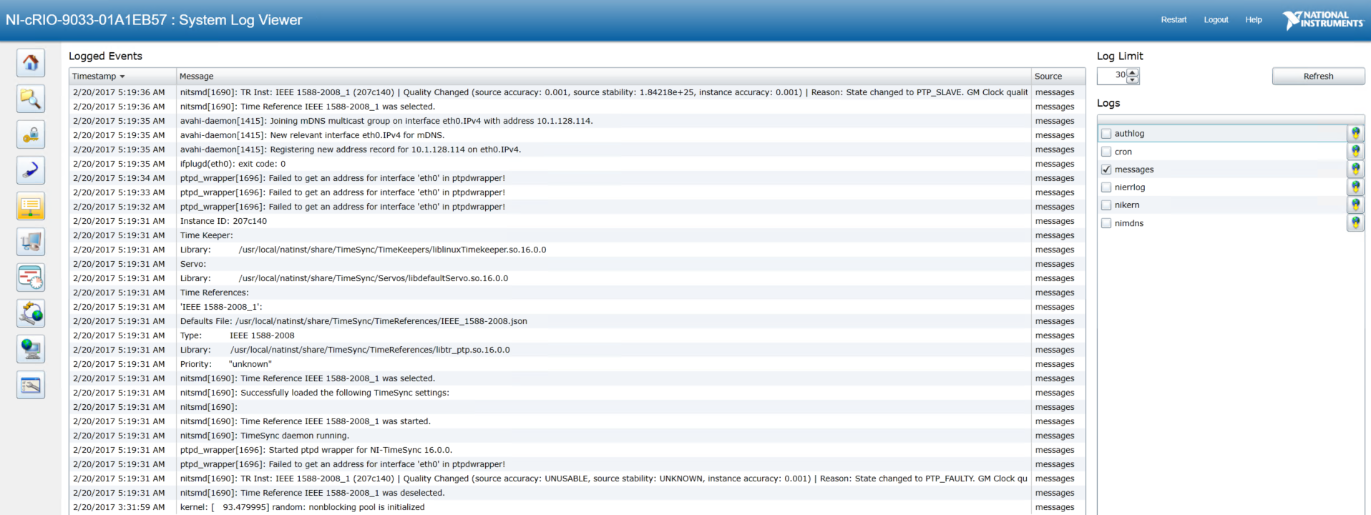
System Log View

Slide 27
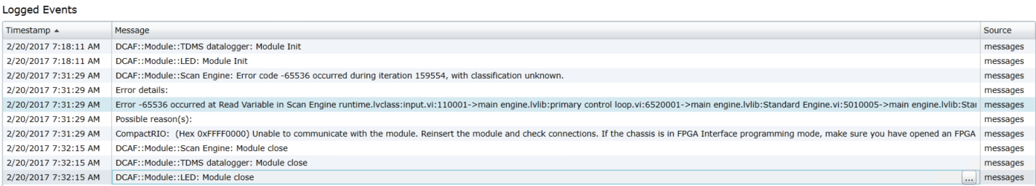
System Log View

Slide 28
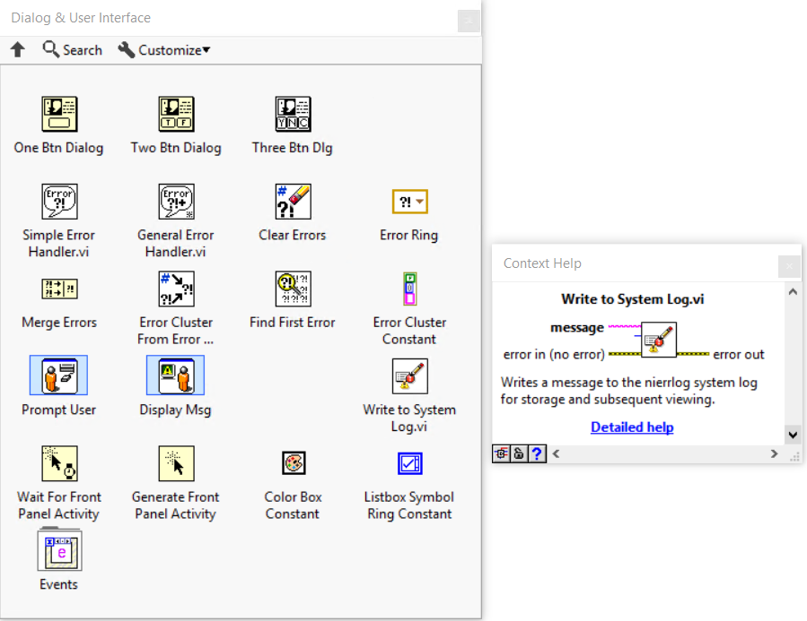
Syslog
NI Linux RT targets already have a syslog-ng daemon running
DCAF taps into the existing background process to log and report messages
You can, too!
Notes:
Add WIF

Slide 29

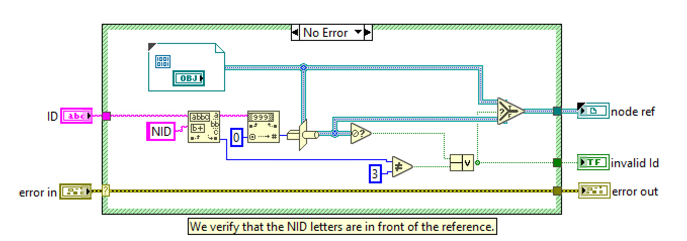
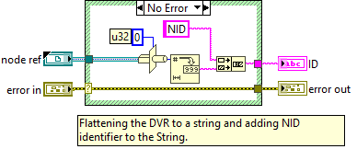

Text to objects DVR
This Feature is from CEF (Configuration Editor Framework)
Allows accessing objects from a string store on a tree

Slide 30
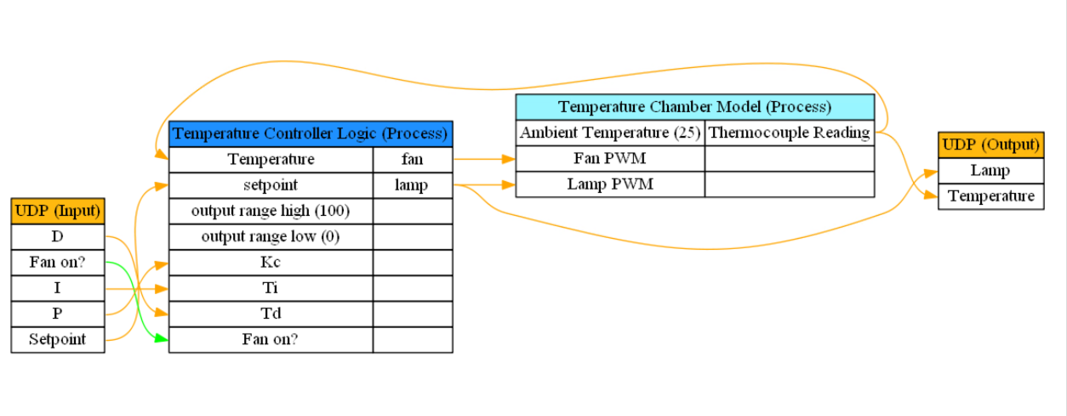
GraphViz
Notes:
http://www.graphviz.org/doc/info/colors.html
C:\Program Files (x86)\National Instruments\LabVIEW 2018\vi.lib\NI\DCAF\Tag Editor Core\Utilities\GraphViz Vizualizations\GraphViz Generator UI Wrapper.vi
C:\Program Files (x86)\National Instruments\LabVIEW 2018\vi.lib\NI\DCAF\Tag Editor Core\Utilities\GraphViz Vizualizations\Generate GraphViz Mapping File.vi

Slide 31
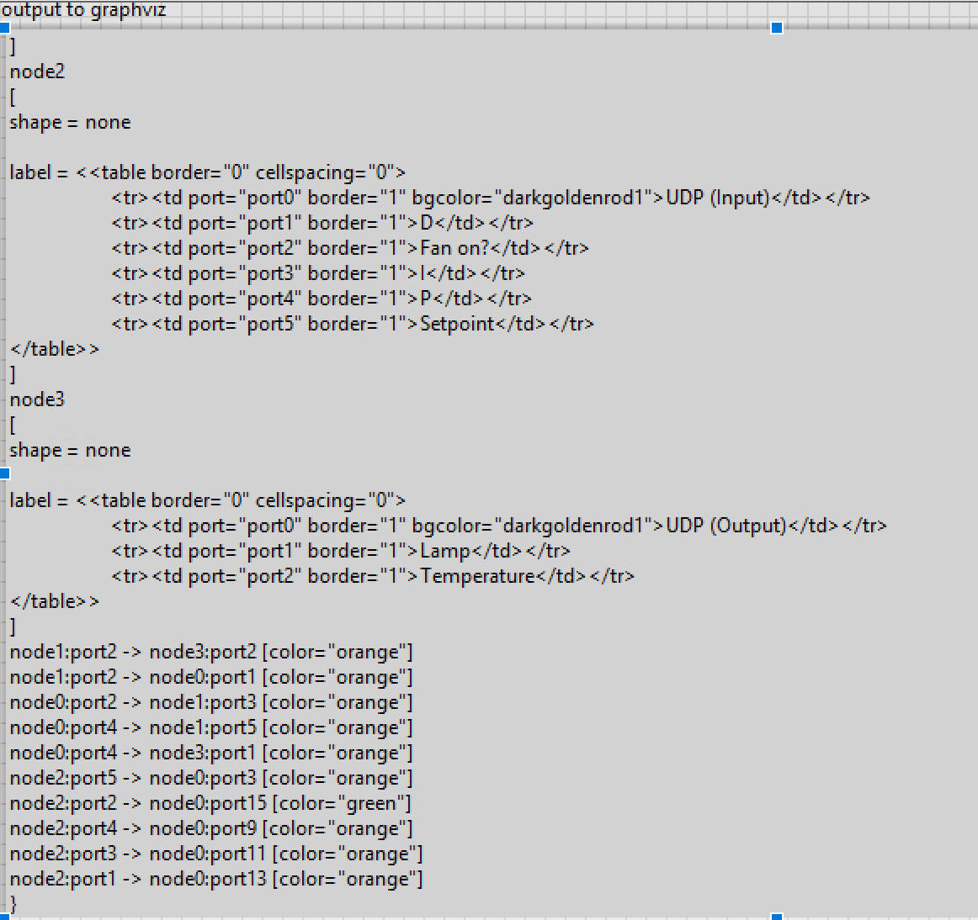
GraphViz
Generate String
Command Line
Display Generated PNG
Notes:
http://www.graphviz.org/doc/info/colors.html
C:\Program Files (x86)\National Instruments\LabVIEW 2018\vi.lib\NI\DCAF\Tag Editor Core\Utilities\GraphViz Vizualizations\GraphViz Generator UI Wrapper.vi
C:\Program Files (x86)\National Instruments\LabVIEW 2018\vi.lib\NI\DCAF\Tag Editor Core\Utilities\GraphViz Vizualizations\Generate GraphViz Mapping File.vi

Slide 32
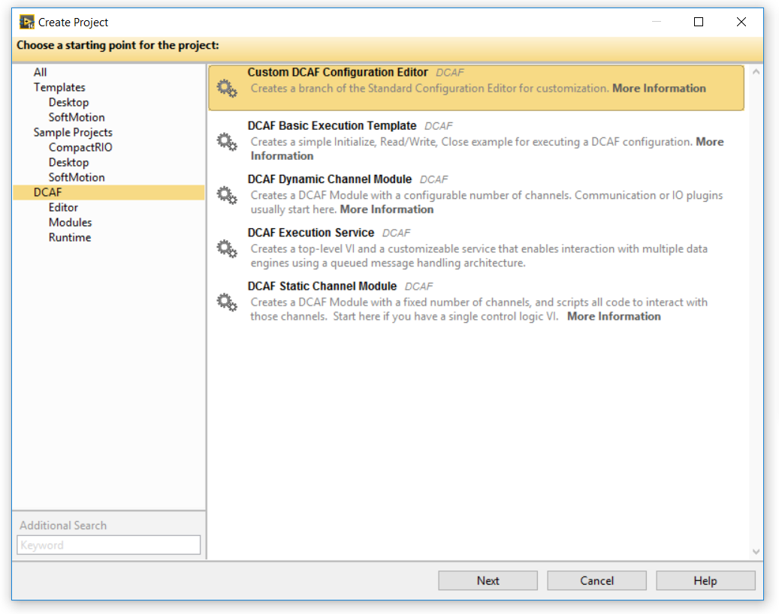
LabVIEW Templates

Slide 33
What’s New In DCAF
Module Import Export Feature
DAQmx Module
System Link Module
Motion Module
OPCUA Client
227 issues closed
93 bug fixes
Notes:
https://github.com/issues?utf8=%E2%9C%93&q=is%3Aissue+user%3ALabVIEW-DCAF+is%3Aclosed+closed%3A%3E%3D2017-05-27+
is:issue user:LabVIEW-DCAF is:closed closed:>=2017-05-27

Slide 34
Future Work
Large channel count improvements (in work)
Additional examples
Support for messages
Sequencer
Additional debugging documentation

Slide 35
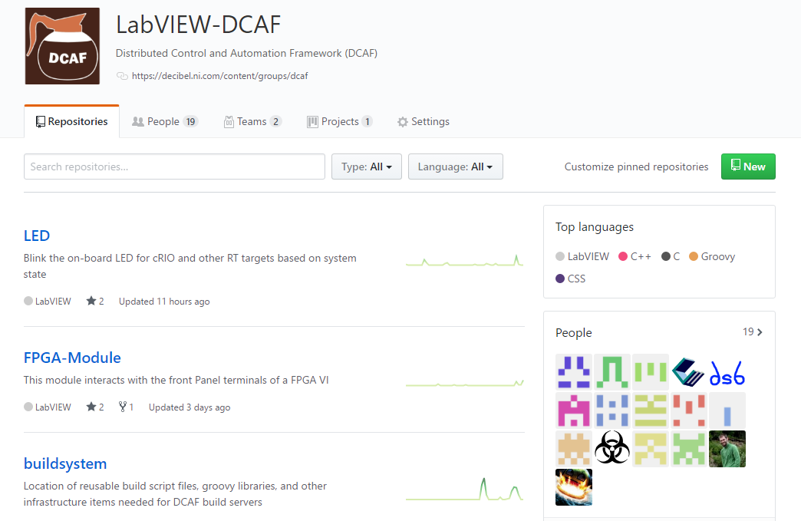
Resources
ni.com/DCAF
Getting started material
Support forum
github.com/LabVIEW-DCAF
Issue reporting
Pull requests welcome!
Includes documentation repository

